Slide 1


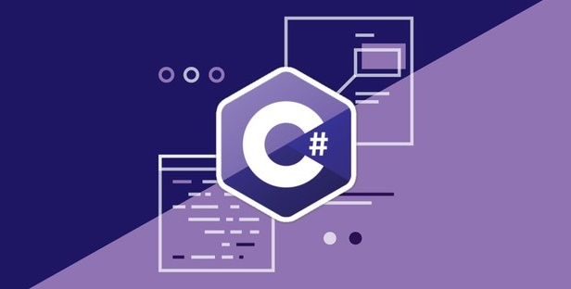
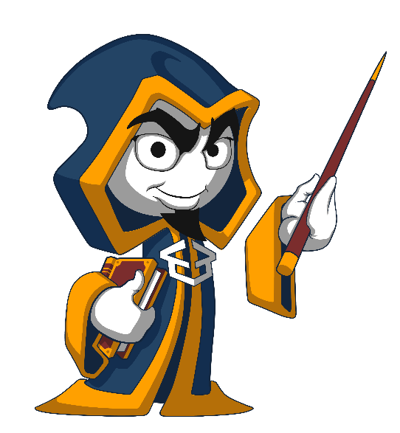
Programming Fundamentals
Course Introduction
Programming Fundamentals
SoftUni Team
Technical Trainers
Software University
http://softuni.bg

Slide 2
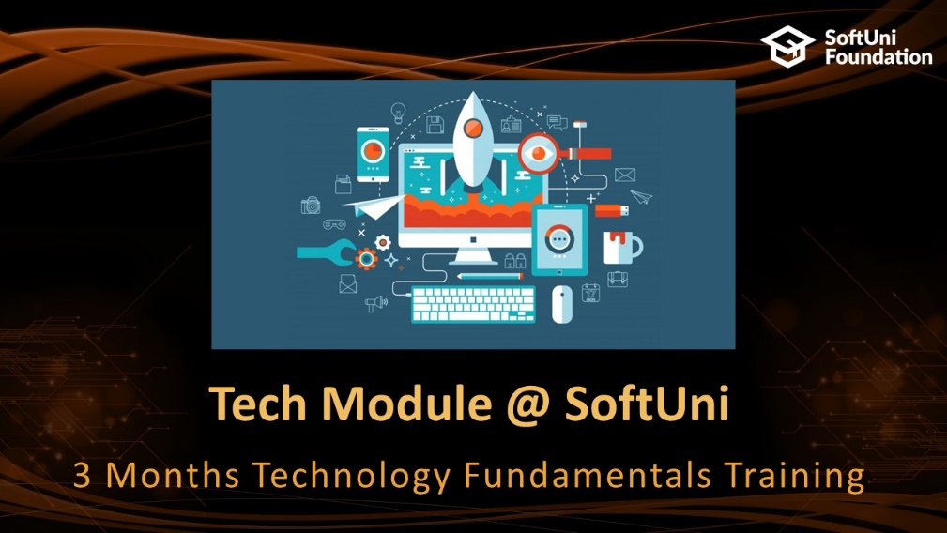






Table of Contents

Slide 3










SoftUni Diamond Partners

Slide 4
Questions
sli.do #tech-softuni

Slide 5

Tech Module @ SoftUni
3 Months Technology Fundamentals Training

Slide 6
Tech Module: Goals
"Technology Fundamentals" Module @ SoftUni
4 times weekly, lots of live coding and exercises
Part I – Programming Fundamentals
Arrays, lists, dictionaries, collections, lambda and LINQ, objects, files, strings, regular expressions, …
Part II – Software Technologies
Get acquainted with the most popular technologies out today
HTML, PHP Web, JavaScript Web, Java Web, C# Web

Slide 7
Tech Module at SoftUni – Timeline
22-Jan-2018
6-Mar-2018
Apr-2018
Programming Fundamentals
6 credits
6 weeks x 4 times / week
Final exam: 4-March-2018
Software Technologies
12 credits
7 weeks x 5 times / week
Final exam: 22-April-2018
Programming Fundamentals Re-Take Exams
TBA

Slide 8
Professions @ SoftUni
Programming Basics
Java
Fund.
Java
DB
Java
Web
JS Core
Tech Module
C#
Fund.
C#
DB
C#
Web
JS Core
Programming Fundamentals
JS Core
MEAN
Stack
Front End
Software Technologies
PHP
Web
Front End
JS Core
https://softuni.bg/curriculum
https://softuni.bg/trainings/courses

Slide 9

Programming Fundamentals
Course Objectives & Program

Slide 10


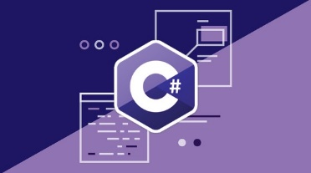
Programming Fundamentals – Course Program
Course Introduction – Course Program, Trainers, Exams, Resources
C# Intro: Basic Syntax, Using Visual Studio
C# Intro: Conditional Statements and Loops
Data Types – Numeral Types and Type Conversion
Methods and Debugging – Finding and Fixing Bugs in Programs
Arrays – Simple Array Processing
Lists – Processing Variable Length Sequences

Slide 11
Programming Fundamentals – Course Program (2)
Dictionaries, Lambda and LINQ – Collections and Queries
Objects and Simple Classes – Use / Define Objects and Classes
Strings and Text Processing – Processing and Manipulating Text
Regular Expressions – Modern Text Processing
Files, Directories, Exceptions – Working With the File System and Handling Exceptions
Exam Preparation – Practical Exam Problems (3 times)
Practical Exam – 4 Problems for 6 Hours

Slide 12

The Trainers Team

Slide 13
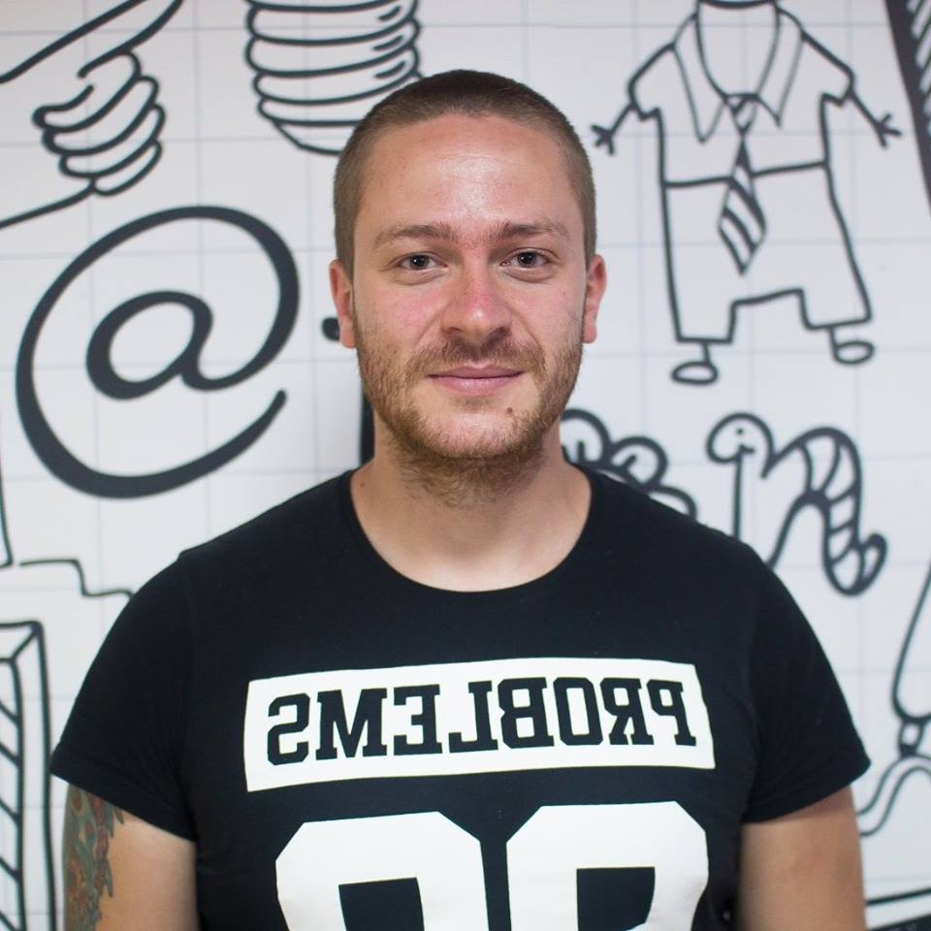
Trainers Team
Ivaylo Kenov
Various job titles at the same time:
Mathematical competitions champion
Full Stack Technical Trainer
Senior Software Developer
Solution Architect & Technical Lead
One-man army @ My Tested ASP.NET
Contacts:
https://github.com/ivaylokenov
https://facebook.com/ivaylo.kenov
https://linkedin.com/in/kenov

Slide 14
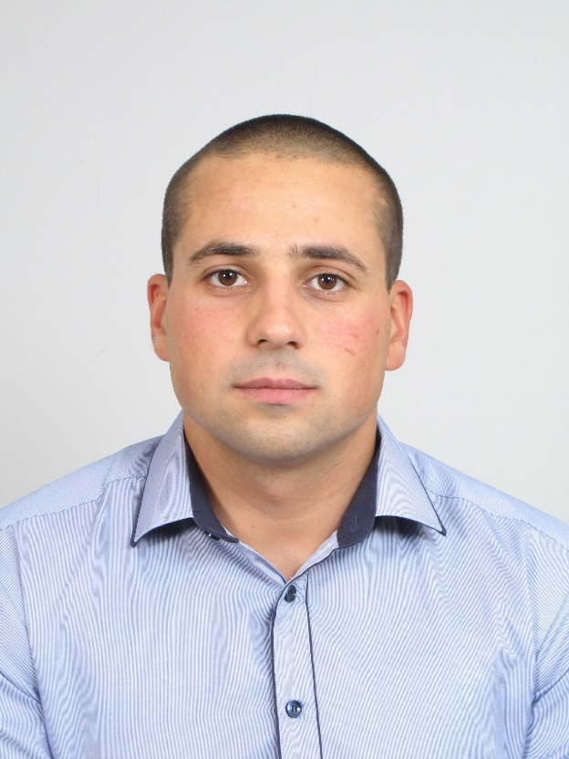
Trainers Team
Martin Paunov
Trainer @ Software University
Passionate about C# and C++
Interested in algorithms and evolution of Artificial Intelligence
Top performing student @ SoftUni

Slide 15

Programming Fundamentals: More Details
Duration, Languages, Technologies

Slide 16


Training Duration – Programming Fundamentals
Lessons: ~50 hours (onsite + videos)
Practical exercises (in class): ~60 hours
Exam preparation: 3*4 hours
Exam: 6 hours
Schedule: January – March 2018
Exam date: 4 March 2018

Slide 17



Why English?
Why the slides are in English?
English is the native language of the software engineers
Specific terminology should be in English
Translations are inaccurate and funny
Just learn English!
No excuses

Slide 18



Learn to Search in Internet & Find Solutions!
The course assignments require to search in Internet
This is an important part of the learning process
Some exercises intentionally have no hints
Learn to find solutions!
Software development includes everyday searching and learning
No excuses, just learn to study!
Developers learn new technologies, tools, languages every day!

Slide 19
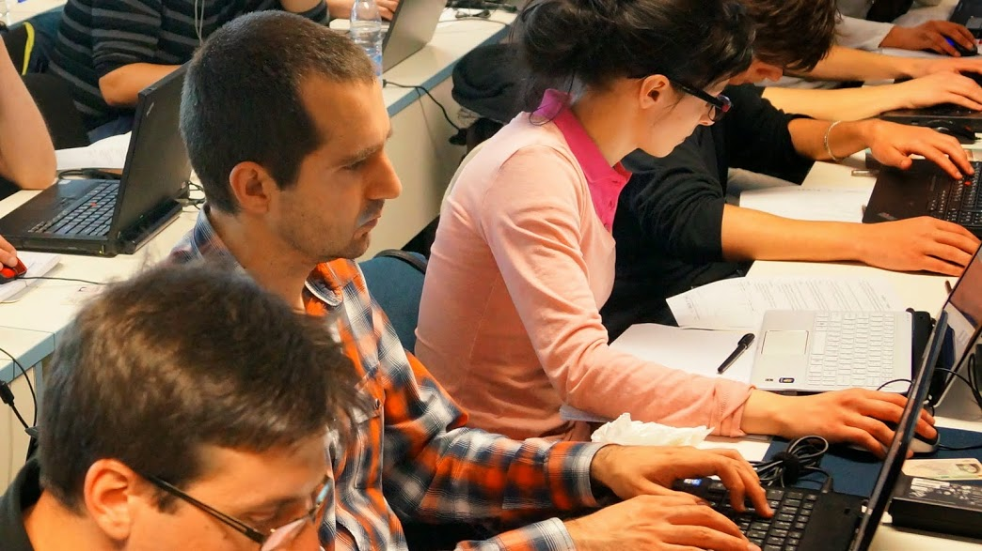

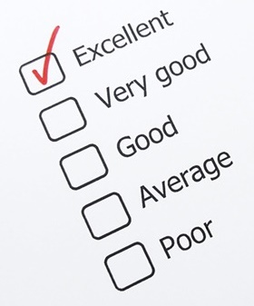
Programming Fundamentals
Evaluation Criteria

Slide 20


Scoring System for “Programming Fundamentals”
Exam – 90%
Homework (exercises) – 10%
Bonuses: up to 10%
Presence in class: 5% (onsite students only)
Forum activities
Others

Slide 21
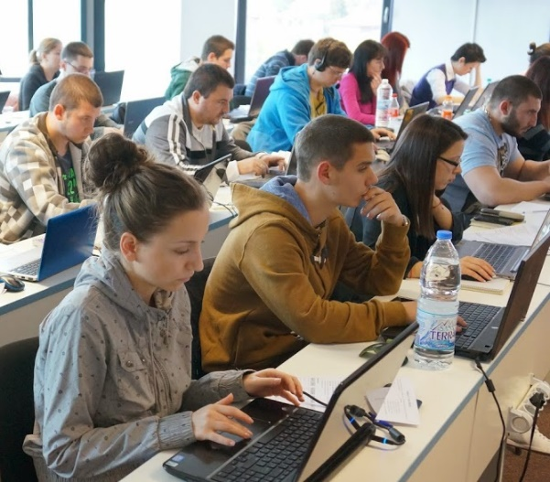

Programming Fundamentals Exam
Practical programming exam
4 practical problems for 6 hours
Simple arrays, lists, dictionaries, strings
Code in C# (Java, PHP, JS are also welcome)
Automated judge system
http://judge.softuni.bg
Solutions are evaluated for correctness only
Code quality is still not measured

Slide 22

Homework Assignments
Doing your homework is very important!
Programming can only be learned through a lot of practice!
You should write code every day!
Each lesson is followed by many exercises
Try to solve them in class
The rest are your homework
Homework assignments are due in 6 days after each lecture
Submission through our online judge system: judge.softuni.bg

Slide 23










Resources
What We Need Additionally?

Slide 24
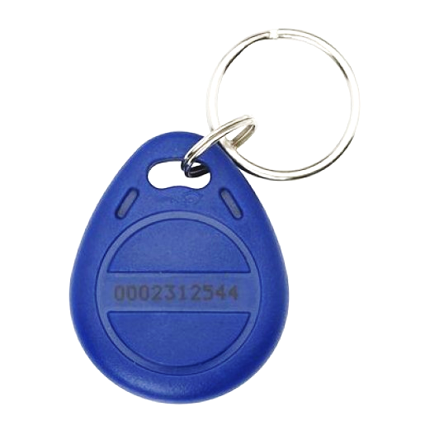
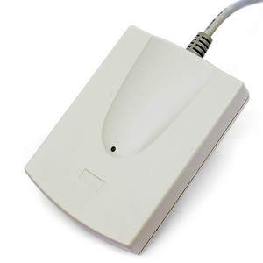
Your RFID Chip
Students can either
Take RFID chip from SoftUni
Or use their own chip / card
Register your chip number in your SoftUni profile: https://softuni.bg/users/profile/show
Check-in at the reception every time when you come
See your last visits in your profile: https://softuni.bg/users/profile/show

Slide 25



PF Course Web Site, Forum and FB Group
Official web site:
Official discussion forum:
Official Facebook group:
softuni.bg/courses/programming-fundamentals
softuni.bg/forum/categories/44/programming-fundamentals
fb.com/groups/SoftUniTechModuleJanuary2018

Slide 26

The Prog. Fundamentals Slides and Videos
All lecture slides, videos, homework assignments, projects and other resources are open content, available for free
Visit the course web site to access the course resources

Slide 27


The Free C# Fundamentals Textbook
Partial textbook for the course:
"Fundamentals of Computer Programming with C#", by Svetlin Nakov & Co., 2013, ISBN 9789544007737
English and Bulgarian versions (as PDF, ePub, …)
Freely downloadable from: www.introprogramming.info
The C# Programming courses @ SoftUni.bg partially follows the book
Programming Fundamentals → chapters 2, 3, 7, 9, 11, 13, 14, 16, 18, 22

Slide 28

Software University Learning System (SULS)
Software University Learning System (SULS)
www.softuni.bg
Important resource for students
Homework submissions
Homework check-up
Exams and results
Reports about your progress
…

Slide 29


Required Software
Software needed for this course:
Microsoft Windows (Win 10 / 8.1 / Win8 / Win7) or Mac or Linux
Visual Studio Community 2017 (a free version of VS 2017)
Older versions are acceptable, but not recommended
Alternative: MonoDevelop (for Linux / old Windows)

Slide 30


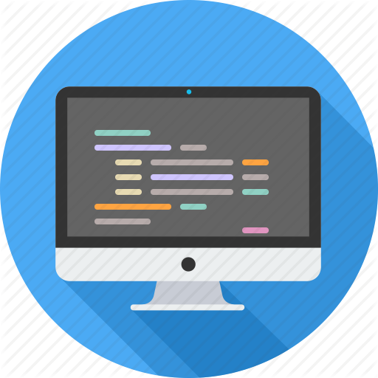

Summary
Training program
Data types, methods, debugging, arrays and lists, dictionaries, objects, strings and much more
Practical exam
4 problems for 6 hours
Learning resources
Slides, videos, software, books, forum

Slide 31



Programming Fundamentals – Course Overview
https://softuni.bg/courses/programming-fundamentals

Slide 32
License
This course (slides, examples, demos, videos, homework, etc.) is licensed under the "Creative Commons Attribution-NonCommercial-ShareAlike 4.0 International" license

Slide 33





Trainings @ Software University (SoftUni)
Software University – High-Quality Education, Profession and Job for Software Developers
softuni.bg
Software University Foundation
http://softuni.foundation/
Software University @ Facebook
facebook.com/SoftwareUniversity
Software University Forums
forum.softuni.bg

